Slide 1

Superstratum Point Expansion (Expanding Shell of Sphere)

Slide 2
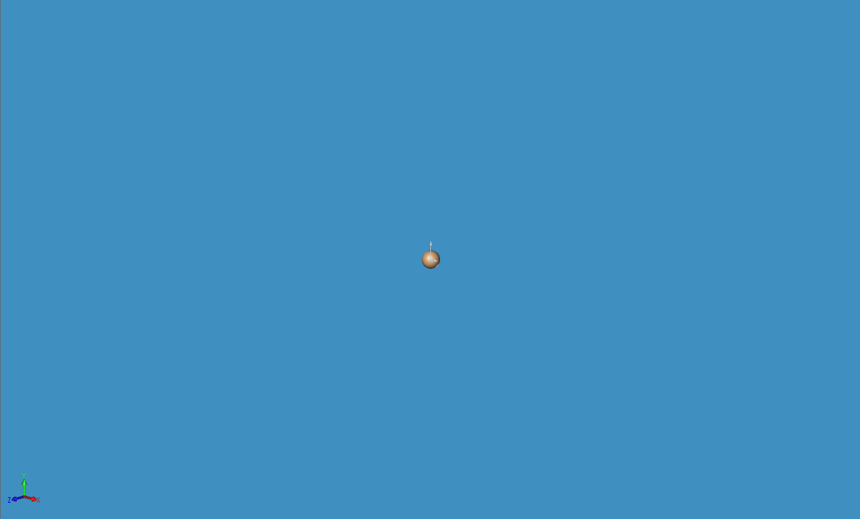
Superstratum Point Expansion (Expanding Shell of Sphere)

Slide 3
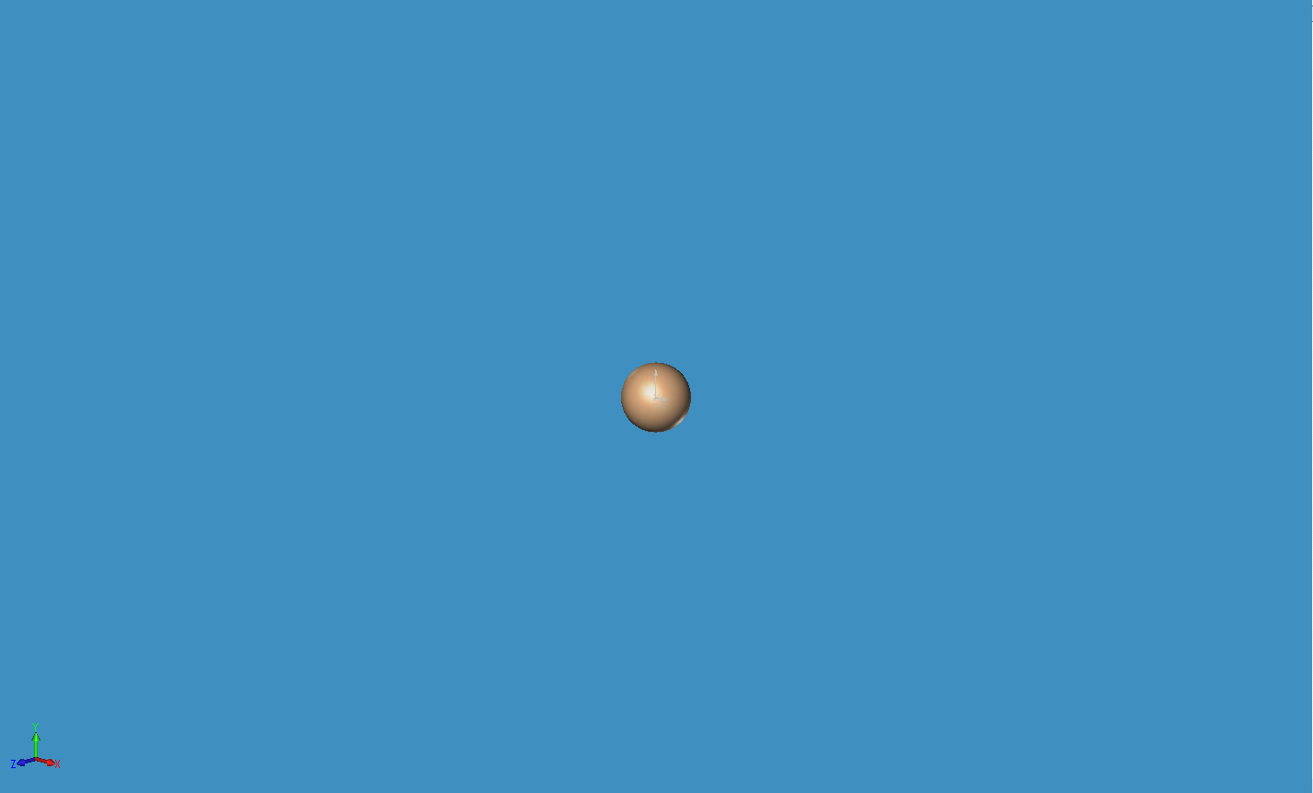
Superstratum Point Expansion (Expanding Shell of Sphere)

Slide 4
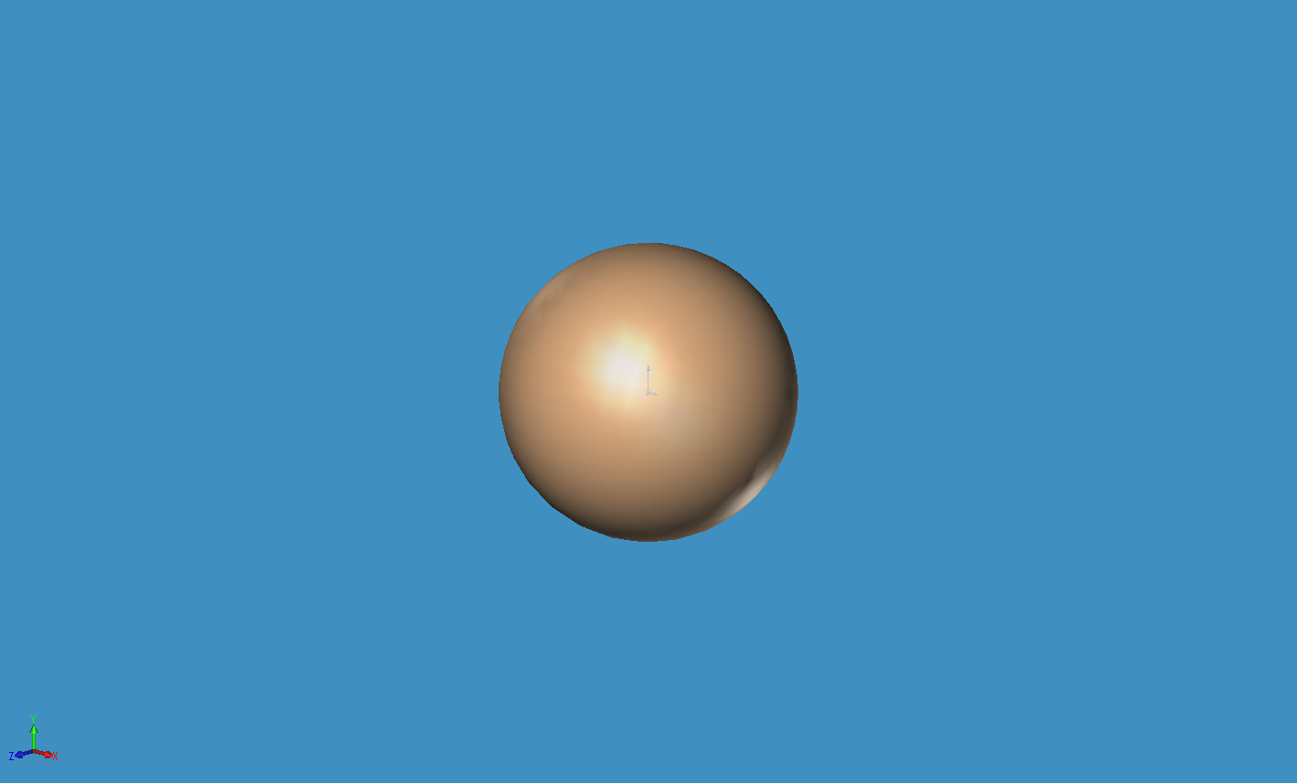
Superstratum Point Expansion (Expanding Shell of Sphere)

Slide 5
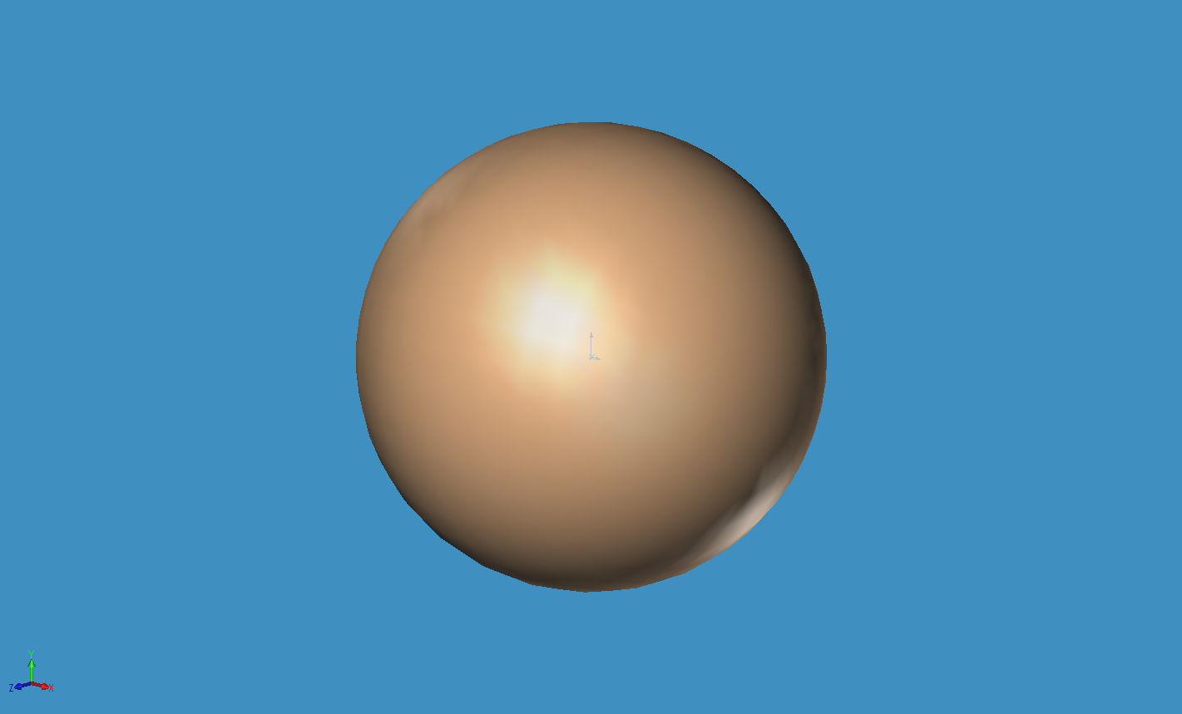
Superstratum Point Expansion (Expanding Shell of Sphere)

Slide 6
Superstratum Point Expansion (Expanding Shell of Sphere)

Slide 7
Superstratum Point Expansion (Expanding Shell of Sphere)

Slide 8
Superstratum Point Expansion (Expanding Shell of Sphere)

Slide 9
Superstratum Point Expansion (Expanding Shell of Sphere)

Slide 10
Superstratum Point Expansion (Expanding Shell of Sphere)

