Slide 1
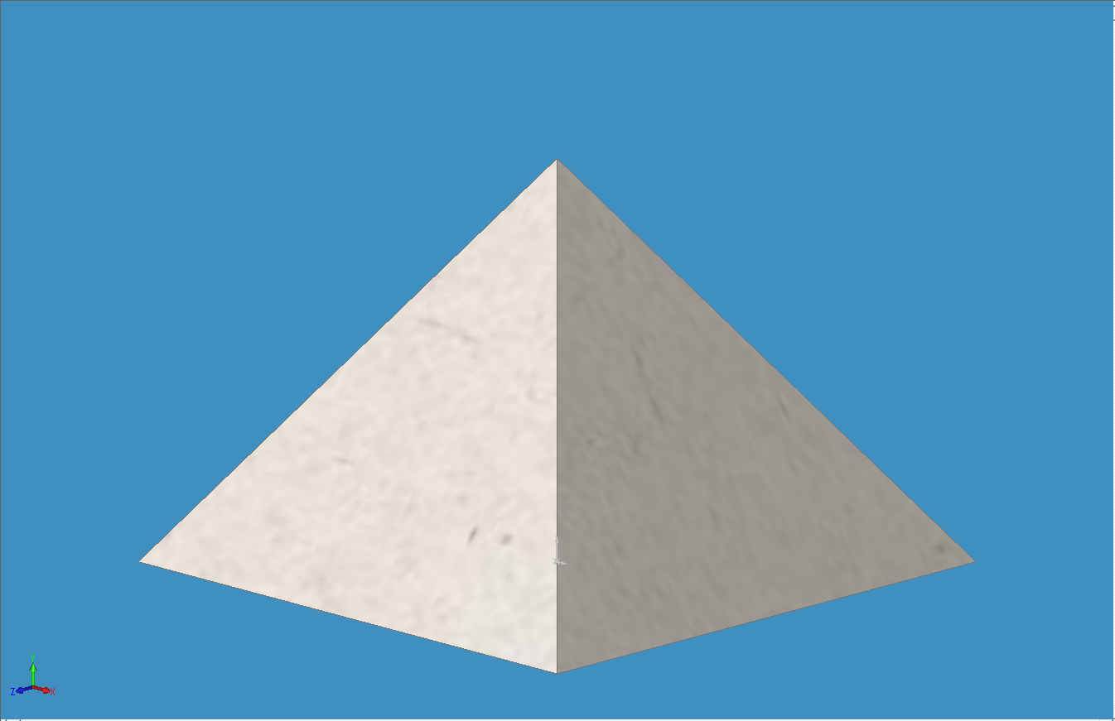
TRANSCENDENTAL PYRAMID DEFORMATION OCCURING IN GEOMETRIC ZONE OF UNCERTAINTY
TRANSCENDENTAL PYRAMID DEFORMATION
c
DOGAN GOKCE 2018
DEFORMATION OCCURS IN EDGES
TRANSCENDENTAL PYRAMID
(UNDEFORMED STATE)
DEFORMATION NEUTRAL BASE

Slide 2
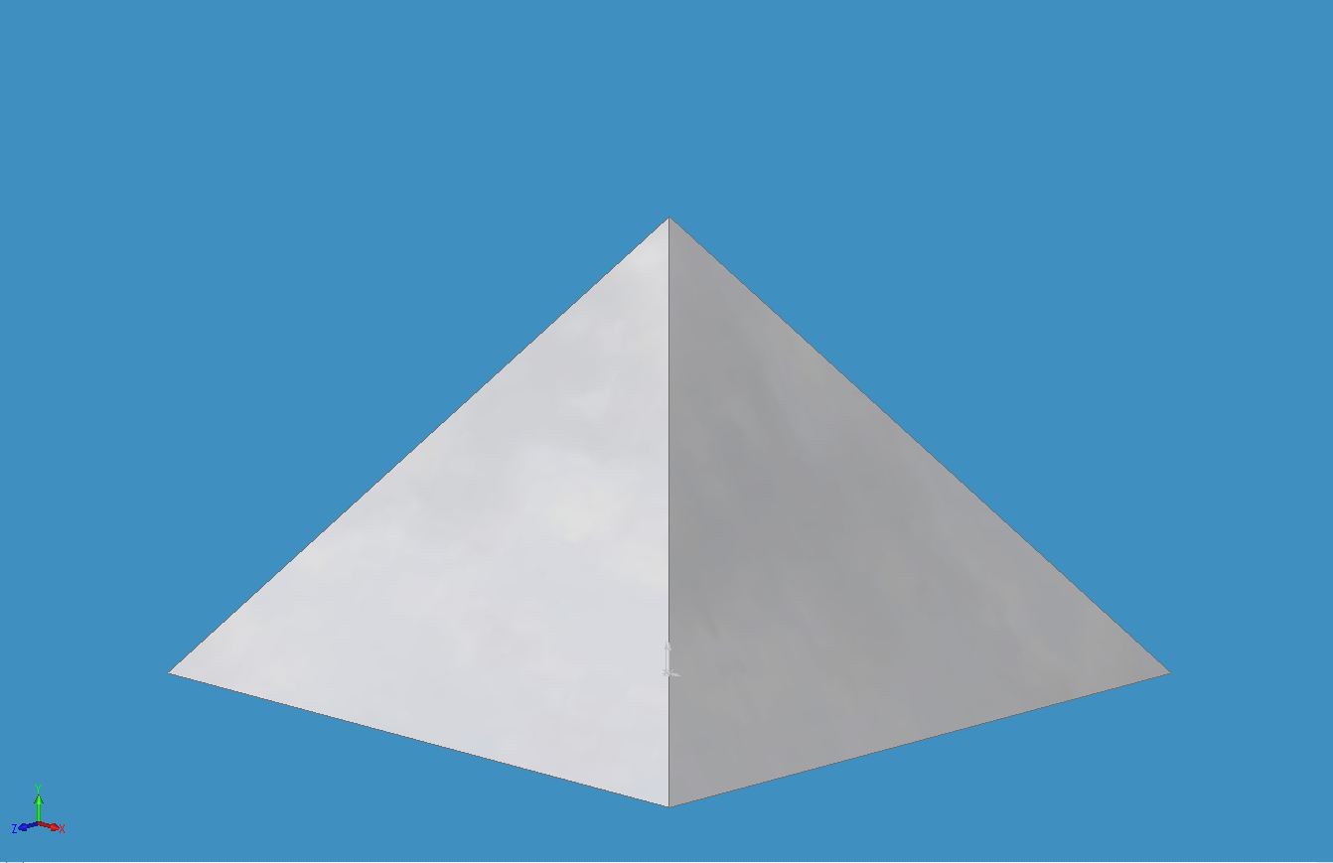
TRANSCENDENTAL PYRAMID DEFORMATION OCCURING IN GEOMETRIC ZONE OF UNCERTAINTY
DEFORMATION OCCURS IN EDGES
TRANSCENDENTAL PYRAMID
(MEDIUM DEFORMATION - KHAFRE)
DEFORMATION NEUTRAL BASE

Slide 3
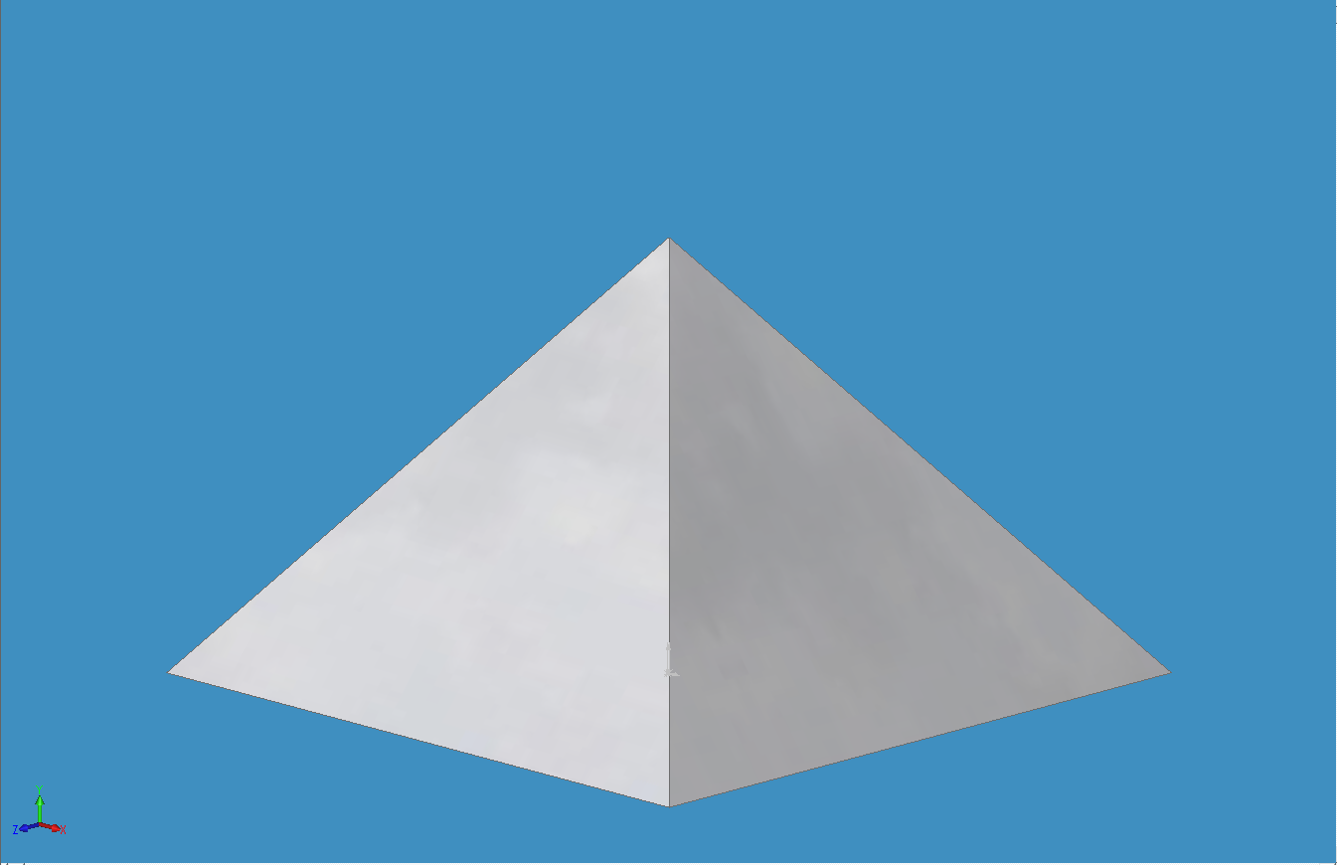
TRANSCENDENTAL PYRAMID DEFORMATION OCCURING IN GEOMETRIC ZONE OF UNCERTAINTY
DEFORMATION OCCURS IN EDGES
TRANSCENDENTAL PYRAMID
(LARGE DEFORMATION - KHUFU)
FOLD LINE
DEFORMATION NEUTRAL BASE

Slide 4
TRANSCENDENTAL PYRAMID DEFORMATION OCCURING IN GEOMETRIC ZONE OF UNCERTAINTY
DEFORMATION OCCURS IN EDGES
TRANSCENDENTAL PYRAMID
(MEDIUM DEFORMATION - KHAFRE)
DEFORMATION NEUTRAL BASE

Slide 5
TRANSCENDENTAL PYRAMID DEFORMATION OCCURING IN GEOMETRIC ZONE OF UNCERTAINTY
DEFORMATION OCCURS IN EDGES
TRANSCENDENTAL PYRAMID
(UNDEFORMED STATE)
DEFORMATION NEUTRAL BASE

Slide 6
TRANSCENDENTAL PYRAMID DEFORMATION OCCURING IN GEOMETRIC ZONE OF UNCERTAINTY
DEFORMATION OCCURS IN EDGES
TRANSCENDENTAL PYRAMID
(MEDIUM DEFORMATION - KHAFRE)
DEFORMATION NEUTRAL BASE

Slide 7
TRANSCENDENTAL PYRAMID DEFORMATION OCCURING IN GEOMETRIC ZONE OF UNCERTAINTY
DEFORMATION OCCURS IN EDGES
TRANSCENDENTAL PYRAMID
(LARGE DEFORMATION - KHUFU)
FOLD LINE
DEFORMATION NEUTRAL BASE

Slide 8
TRANSCENDENTAL PYRAMID DEFORMATION OCCURING IN GEOMETRIC ZONE OF UNCERTAINTY
DEFORMATION OCCURS IN EDGES
TRANSCENDENTAL PYRAMID
(MEDIUM DEFORMATION - KHAFRE)
DEFORMATION NEUTRAL BASE

