Slide 1
RED SQUARE NEBULA COMB FEATURE GENERATION
DOGAN GOKCE 2018
C

Slide 2
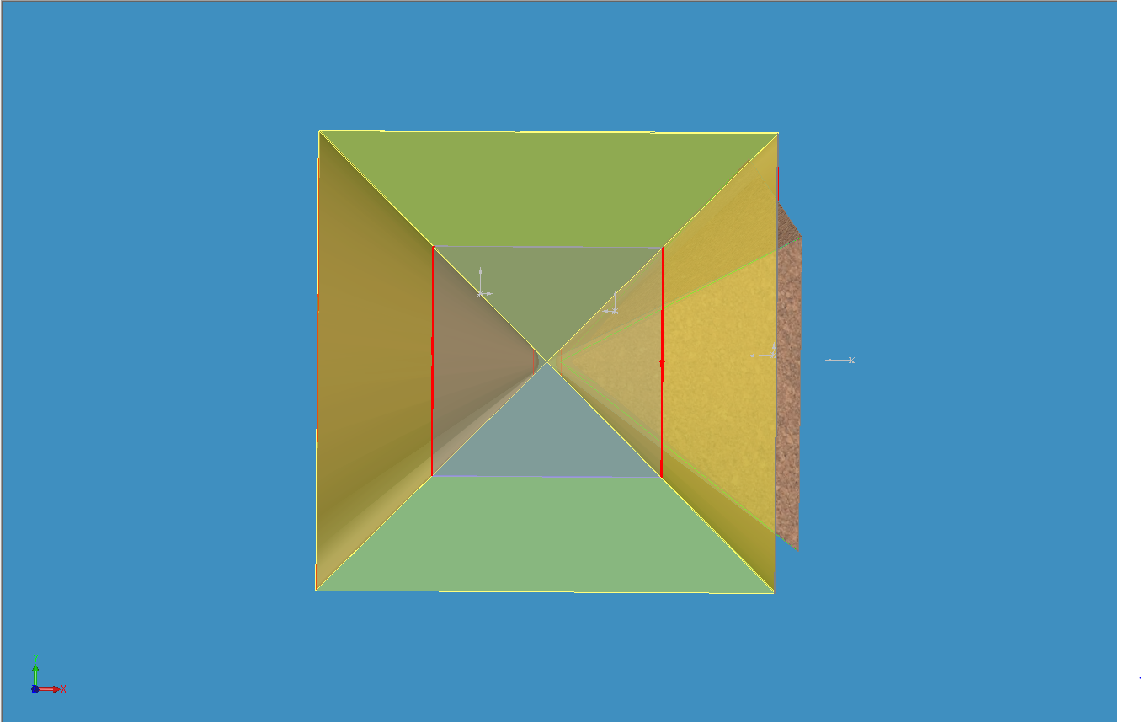
TRANSCENDENTAL PYRAMID SEEDING RED SQUARE NEBULA HYPERCUBE WITH ENERGY DISTRIBUTION
(ANALOG SPHERE REMOVED FOR CLARITY.)
NESTED DIMENSIONAL SUB DOMAIN
TRANSCENDENTAL PYRAMID
HYPERCUBE

Slide 3
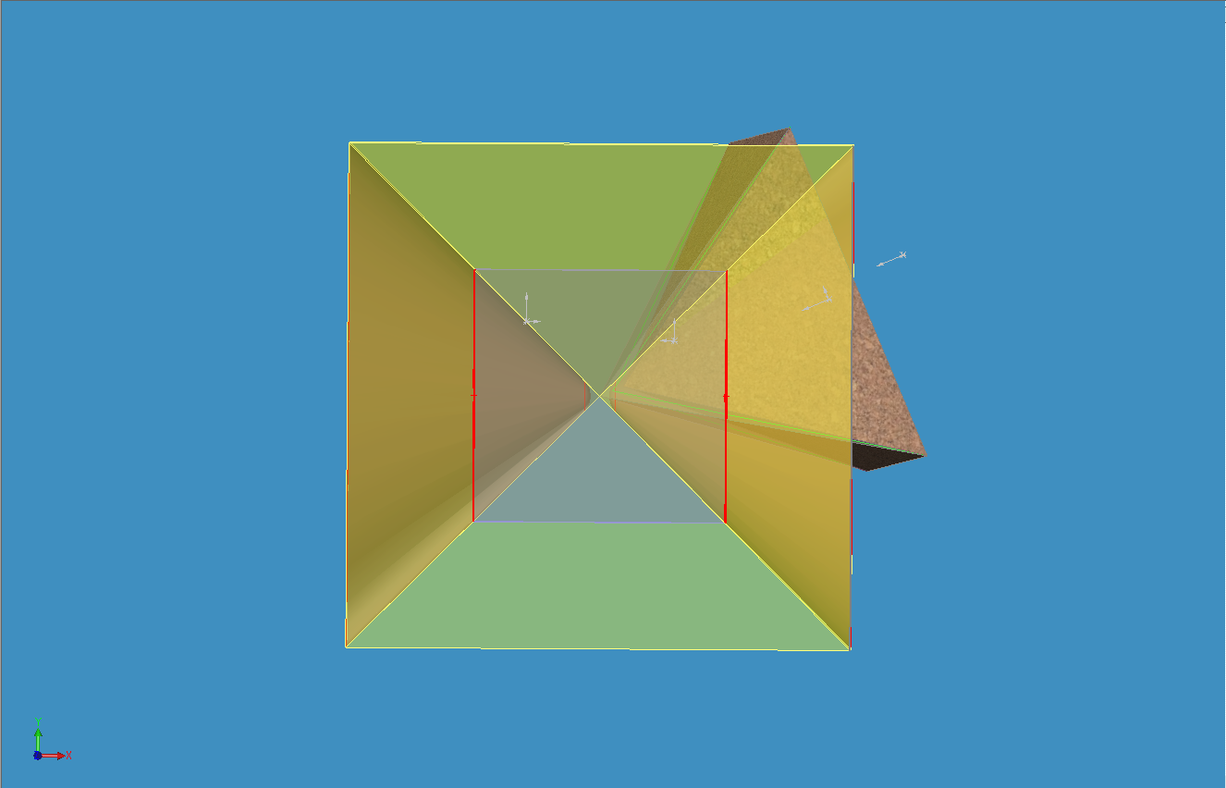
TRANSCENDENTAL PYRAMID SEEDING RED SQUARE NEBULA HYPERCUBE WITH ENERGY DISTRIBUTION
NESTED DIMENSIONAL SUB DOMAIN
COMB FEATURES GENERATED BY EDGES OF PYRAMID AS IT SWEEPS.
SIDE VIEW OF BI-CONE STRUCTURE
HYPERCUBE

Slide 4
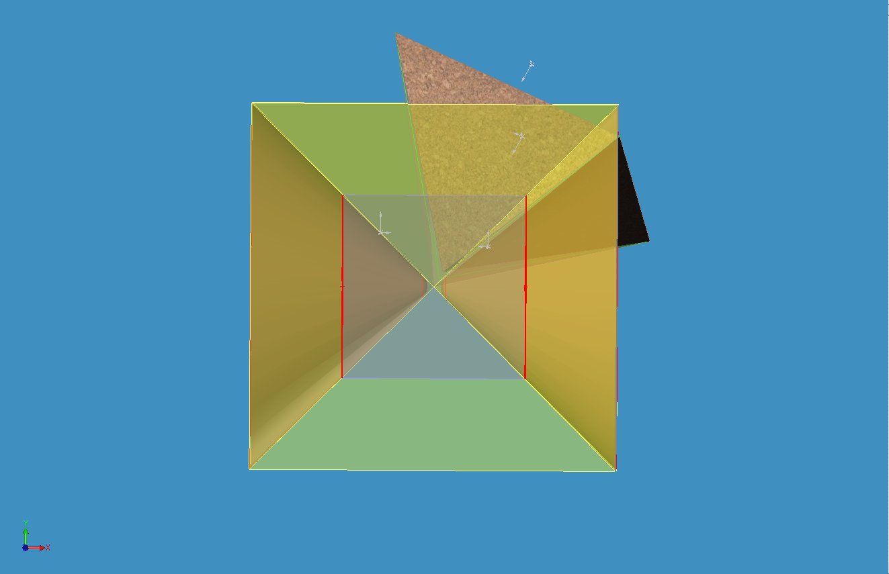
TRANSCENDENTAL PYRAMID SEEDING RED SQUARE NEBULA HYPERCUBE WITH ENERGY DISTRIBUTION
NESTED DIMENSIONAL SUB DOMAIN
COMB FEATURES GENERATED BY EDGES OF PYRAMID AS IT SWEEPS.
SIDE VIEW OF BI-CONE STRUCTURE
HYPERCUBE

Slide 5
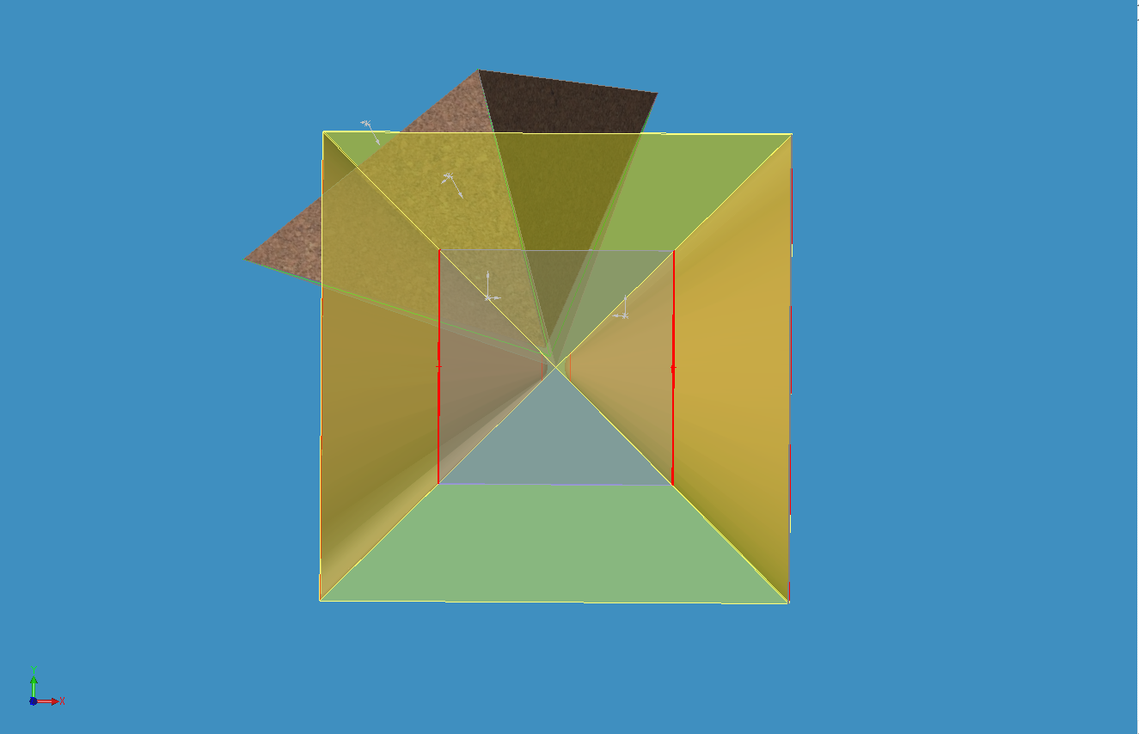
TRANSCENDENTAL PYRAMID SEEDING RED SQUARE NEBULA HYPERCUBE WITH ENERGY DISTRIBUTION
NESTED DIMENSIONAL SUB DOMAIN
COMB FEATURES GENERATED BY EDGES OF PYRAMID AS IT SWEEPS.
SIDE VIEW OF BI-CONE STRUCTURE
HYPERCUBE

Slide 6
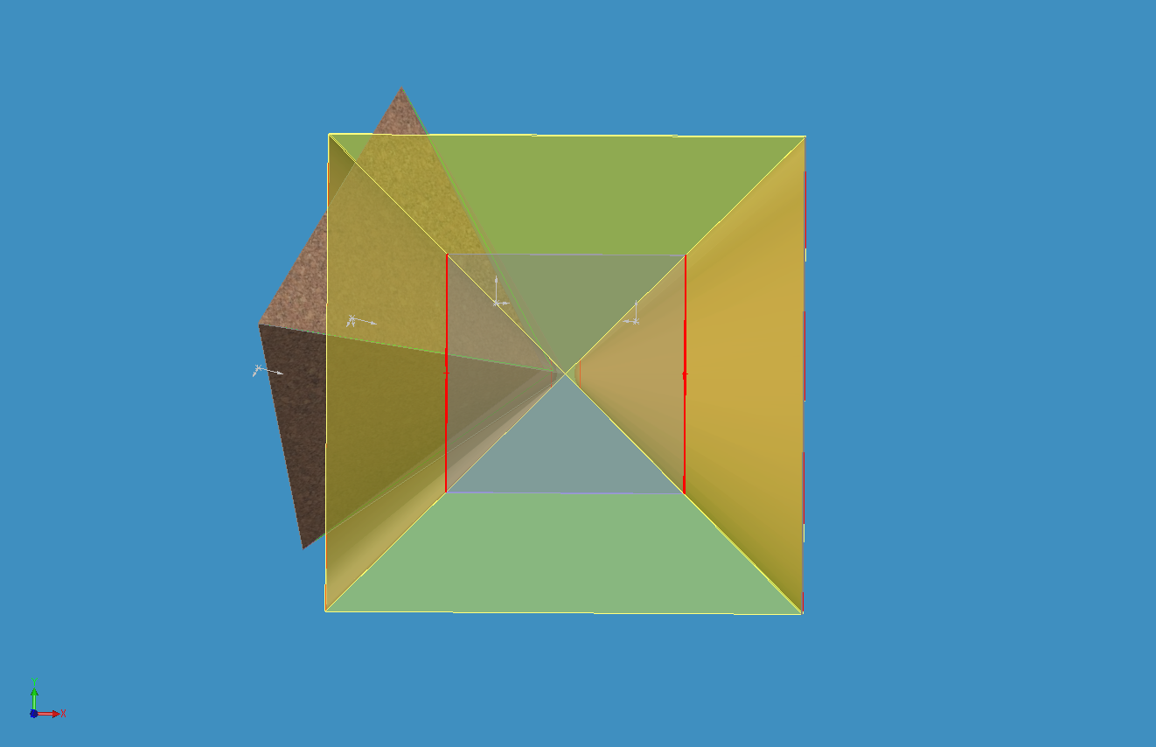
TRANSCENDENTAL PYRAMID SEEDING RED SQUARE NEBULA HYPERCUBE WITH ENERGY DISTRIBUTION
NESTED DIMENSIONAL SUB DOMAIN
COMB FEATURES GENERATED BY EDGES OF PYRAMID AS IT SWEEPS.
SIDE VIEW OF BI-CONE STRUCTURE
HYPERCUBE

Slide 7
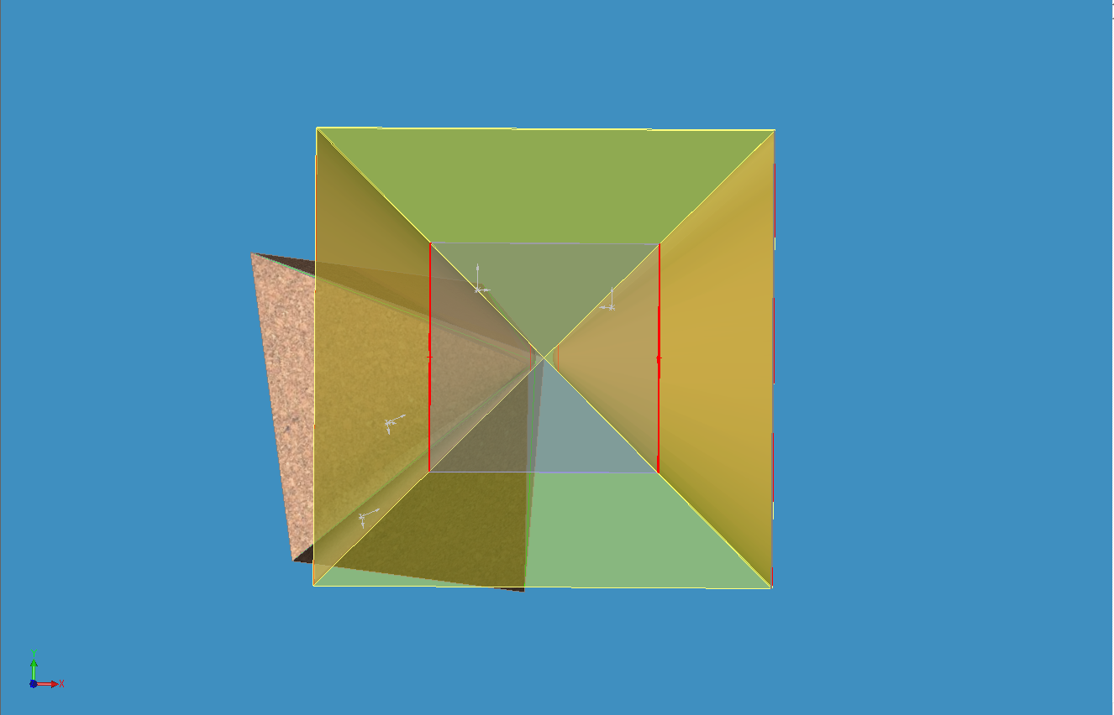
TRANSCENDENTAL PYRAMID SEEDING RED SQUARE NEBULA HYPERCUBE WITH ENERGY DISTRIBUTION
NESTED DIMENSIONAL SUB DOMAIN
COMB FEATURES GENERATED BY EDGES OF PYRAMID AS IT SWEEPS.
SIDE VIEW OF BI-CONE STRUCTURE
HYPERCUBE

Slide 8
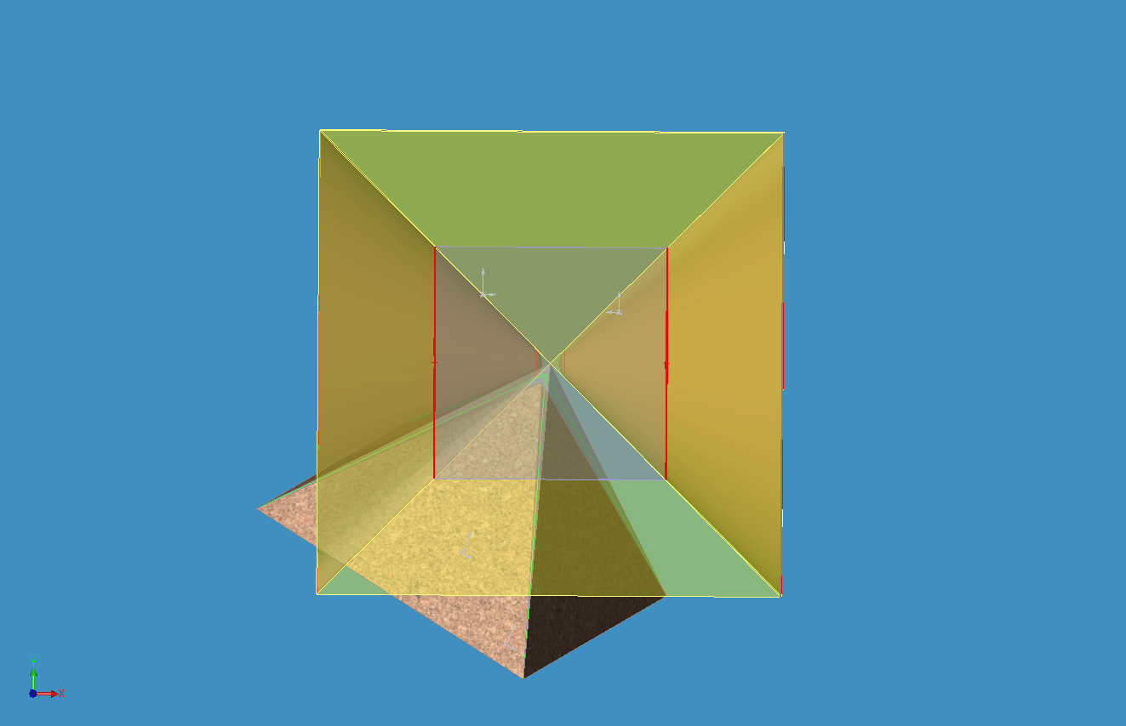
TRANSCENDENTAL PYRAMID SEEDING RED SQUARE NEBULA HYPERCUBE WITH ENERGY DISTRIBUTION
NESTED DIMENSIONAL SUB DOMAIN
COMB FEATURES GENERATED BY EDGES OF PYRAMID AS IT SWEEPS.
SIDE VIEW OF BI-CONE STRUCTURE
HYPERCUBE

Slide 9
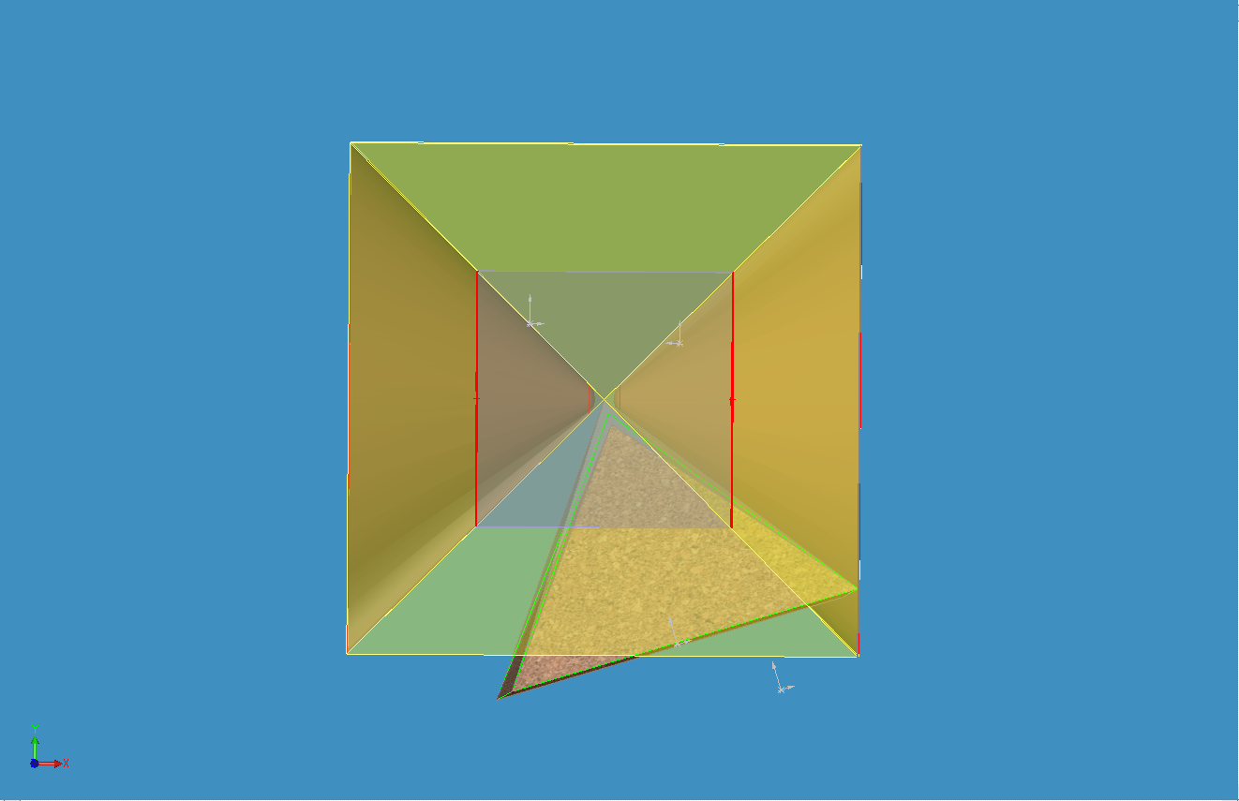
TRANSCENDENTAL PYRAMID SEEDING RED SQUARE NEBULA HYPERCUBE WITH ENERGY DISTRIBUTION
NESTED DIMENSIONAL SUB DOMAIN
COMB FEATURES GENERATED BY EDGES OF PYRAMID AS IT SWEEPS.
SIDE VIEW OF BI-CONE STRUCTURE
HYPERCUBE

