Slide 1
Mesostratum Point Expansion (Transcendental Pyramid)

Slide 2
Mesostratum Point Expansion (Transcendental Pyramid)

Slide 3
Mesostratum Point Expansion (Transcendental Pyramid)

Slide 4
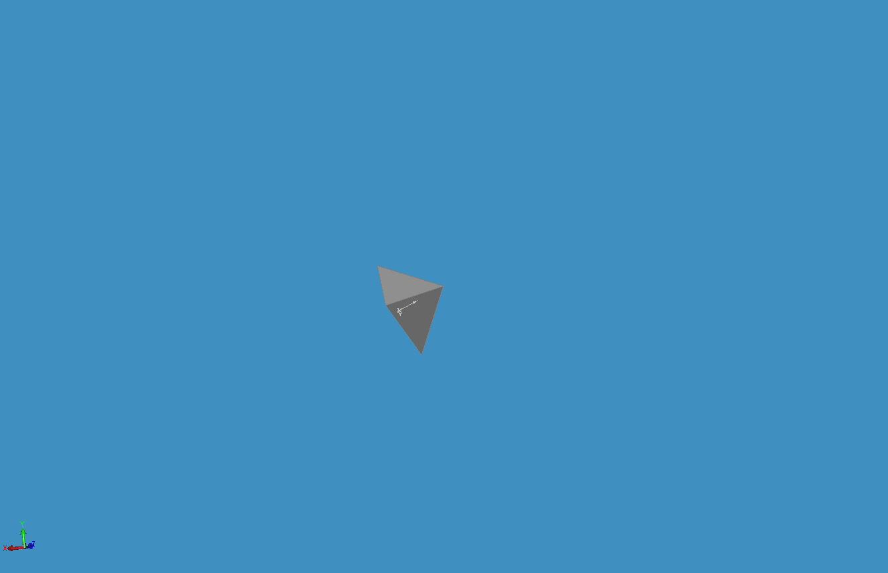
Mesostratum Point Expansion (Transcendental Pyramid)

Slide 5
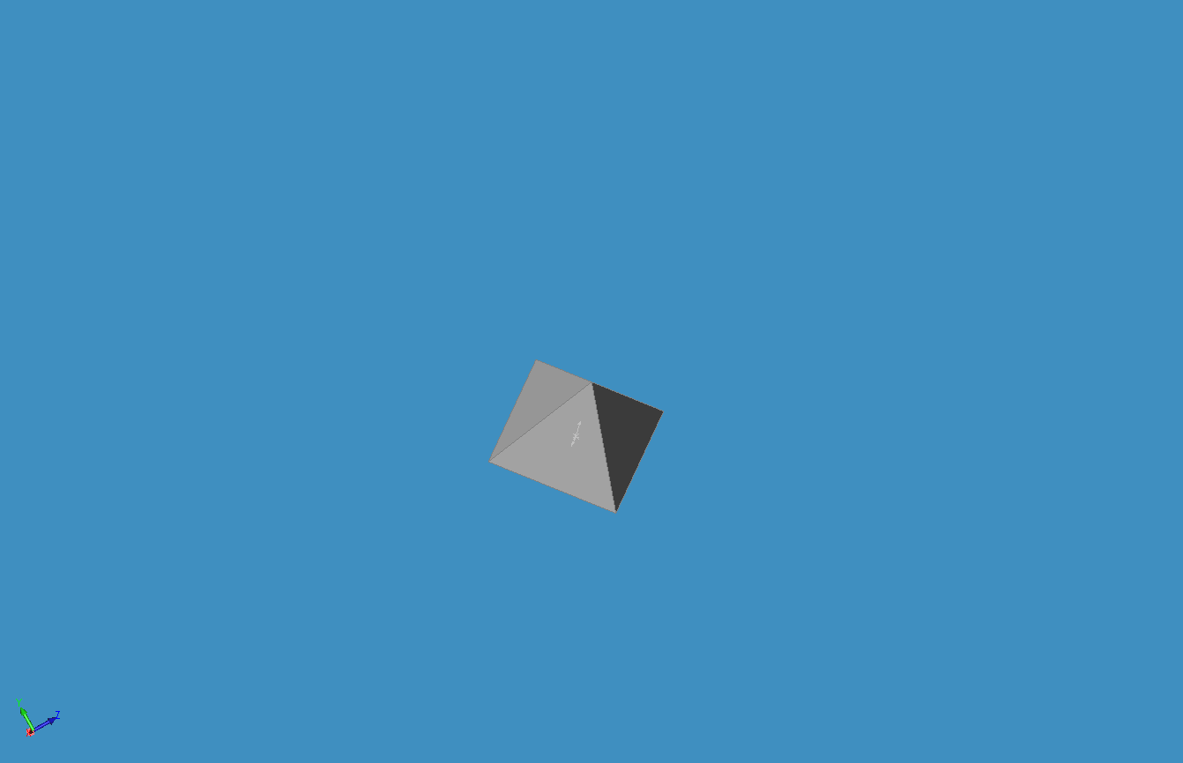
Mesostratum Point Expansion (Transcendental Pyramid)

Slide 6
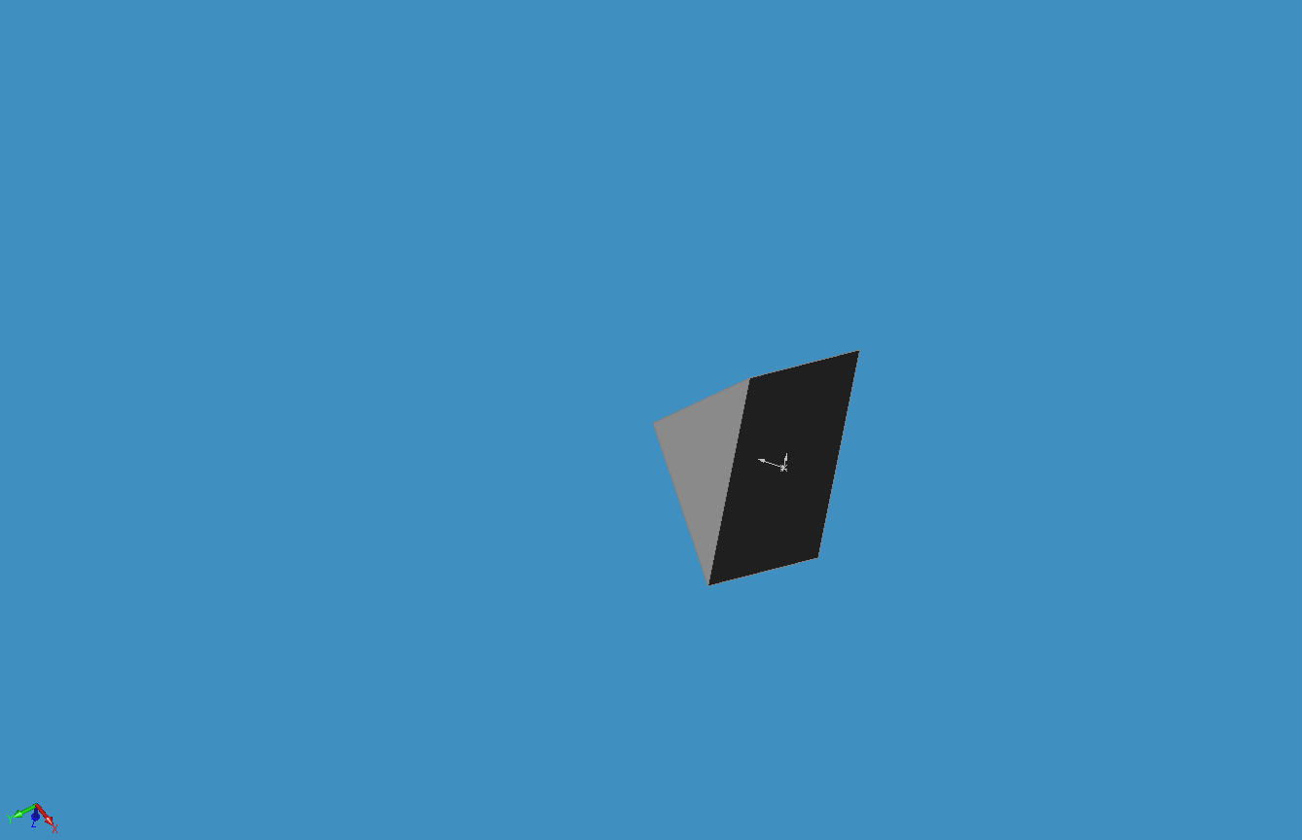
Mesostratum Point Expansion (Transcendental Pyramid)

Slide 7
Mesostratum Point Expansion (Transcendental Pyramid)

Slide 8
Mesostratum Point Expansion (Transcendental Pyramid)

Slide 9
Mesostratum Point Expansion (Transcendental Pyramid)

Slide 10
Mesostratum Point Expansion (Transcendental Pyramid)

Slide 11
Mesostratum Point Expansion (Transcendental Pyramid)

Slide 12
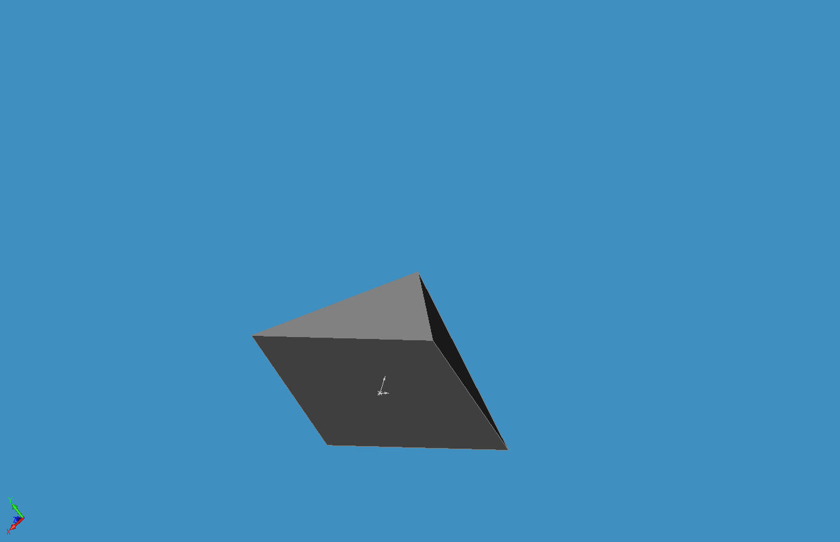
Mesostratum Point Expansion (Transcendental Pyramid)

Slide 13
Mesostratum Point Expansion (Transcendental Pyramid)

Slide 14
Mesostratum Point Expansion (Transcendental Pyramid)

Slide 15
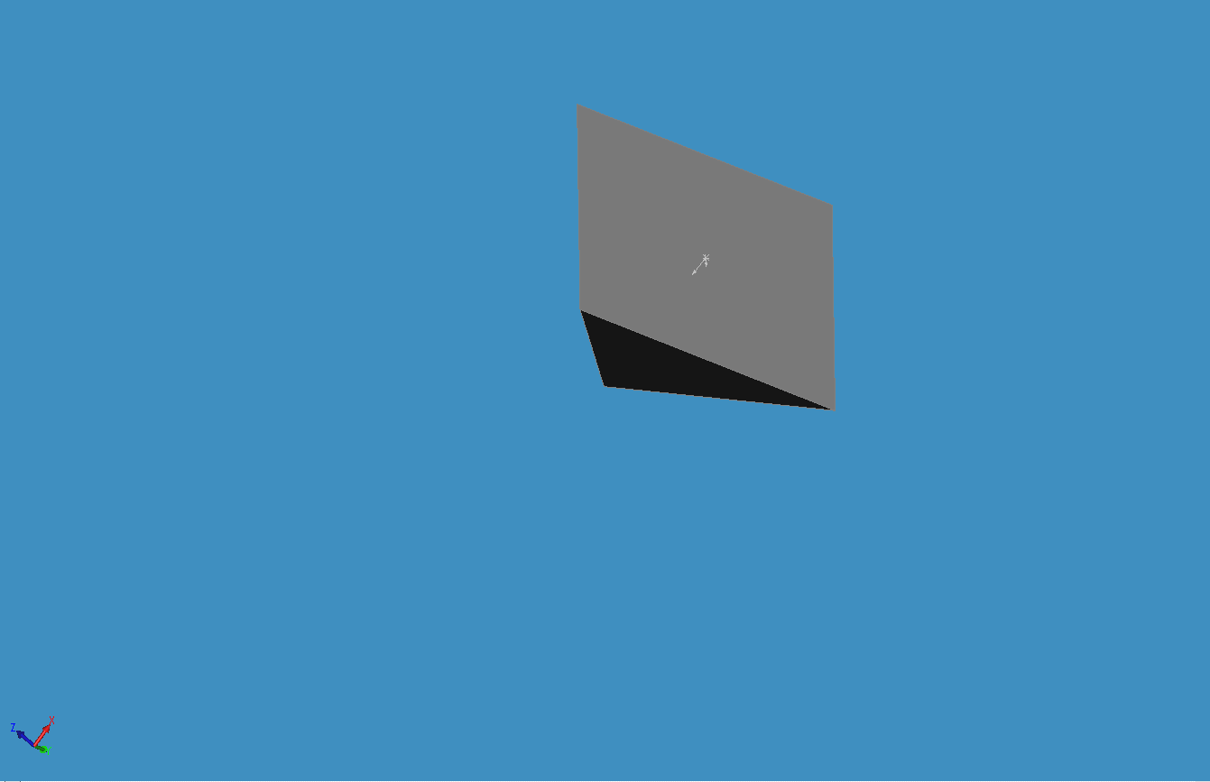
Mesostratum Point Expansion (Transcendental Pyramid)

Slide 16
Mesostratum Point Expansion (Transcendental Pyramid)

Slide 17
Mesostratum Point Expansion (Transcendental Pyramid)

Slide 18
Mesostratum Point Expansion (Transcendental Pyramid)

Slide 19
Mesostratum Point Expansion (Transcendental Pyramid)

Slide 20
Mesostratum Point Expansion (Transcendental Pyramid)

Slide 21
Mesostratum Point Expansion (Transcendental Pyramid)

Slide 22
Mesostratum Point Expansion (Transcendental Pyramid)

Slide 23
Mesostratum Point Expansion (Transcendental Pyramid)

Slide 24
Mesostratum Point Expansion (Transcendental Pyramid)

Slide 25
Mesostratum Point Expansion (Transcendental Pyramid)

Slide 26
Mesostratum Point Expansion (Transcendental Pyramid)

Slide 27
Mesostratum Point Expansion (Transcendental Pyramid)

Slide 28
Mesostratum Point Expansion (Transcendental Pyramid)

Slide 29
Mesostratum Point Expansion (Transcendental Pyramid)

Slide 30
Mesostratum Point Expansion (Transcendental Pyramid)

Slide 31
Mesostratum Point Expansion (Transcendental Pyramid)

Slide 32
Mesostratum Point Expansion (Transcendental Pyramid)

Slide 33
Mesostratum Point Expansion (Transcendental Pyramid)

Slide 34
Mesostratum Point Expansion (Transcendental Pyramid)

Slide 35
Mesostratum Point Expansion (Transcendental Pyramid)

Slide 36
Mesostratum Point Expansion (Transcendental Pyramid)

Slide 37
Mesostratum Point Expansion (Transcendental Pyramid)

Slide 38
Mesostratum Point Expansion (Transcendental Pyramid)

Slide 39
Mesostratum Point Expansion (Transcendental Pyramid)

Slide 40
Mesostratum Point Expansion (Transcendental Pyramid)

Slide 41
Mesostratum Point Expansion (Transcendental Pyramid)

Slide 42
Mesostratum Point Expansion (Transcendental Pyramid)

Slide 43
Mesostratum Point Expansion (Transcendental Pyramid)

Slide 44
Mesostratum Point Expansion (Transcendental Pyramid)

Slide 45
Mesostratum Point Expansion (Transcendental Pyramid)

Slide 46
Mesostratum Point Expansion (Transcendental Pyramid)

Slide 47
Mesostratum Point Expansion (Transcendental Pyramid)

Slide 48
Mesostratum Point Expansion (Transcendental Pyramid)

